Slide 1
Topic Modeling & Word embedding on Wikipedia data Model Training Report
Xiaolong Yang
xyang105@Illinois.edu

Slide 2
Topic Modeling V.S Word embedding
The main difference between these is the contextual information use:
Topic models use documents as contexts
Word embedding models use words as contexts.
These difference capture different types of semantic similarity
The document-based capture semantic relatedness (e.g. “boat” – “water”)
The word-based models capture semantic similarity (e.g. “boat” – “ship”).

Slide 3
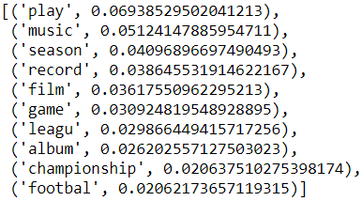
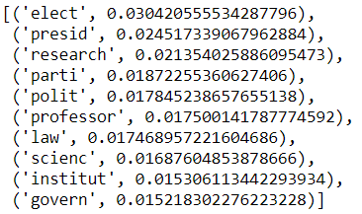
Topic Modeling– 2 topics
Artist + Athlete
Politician + Scientist

Slide 4
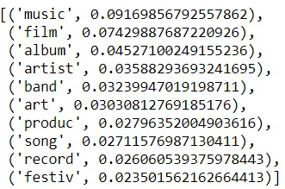
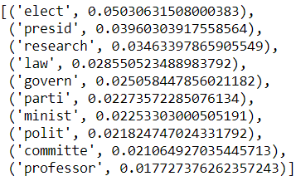
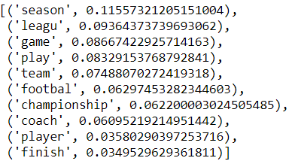
Topic Modeling– 3 topics
Artist
Politician + Scientist
Athlete

Slide 5
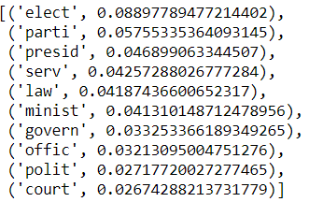
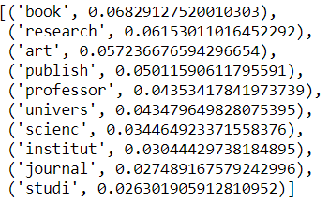
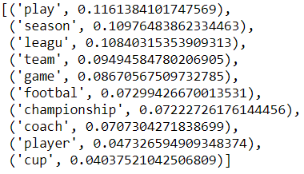
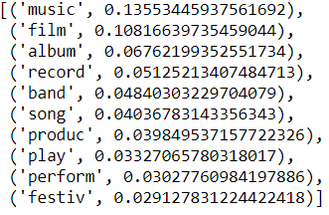
Topic Modeling– 4 topics
Politician
Scientist
Athlete
Artist

Slide 6
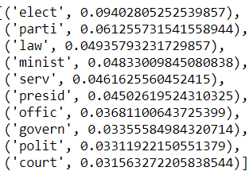
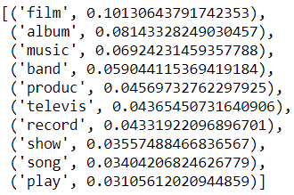
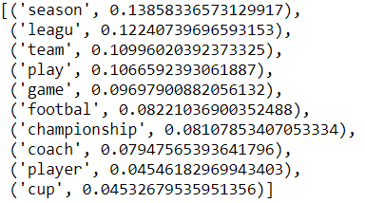
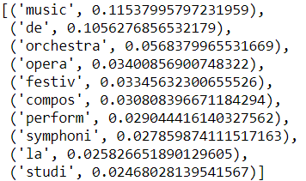
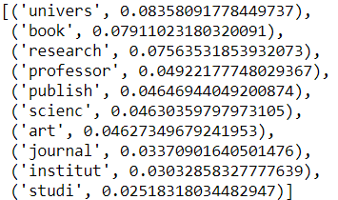
Topic Modeling– 5 topics
Politician
Artist - 2
Athlete
Artist - 1
Scientist

Slide 7
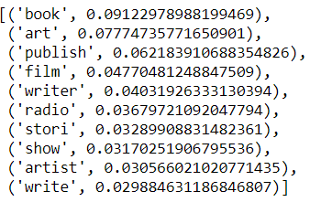
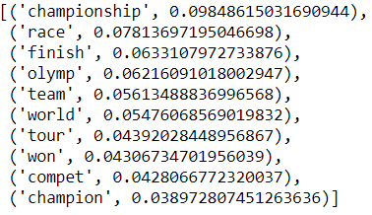
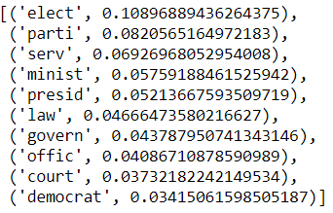
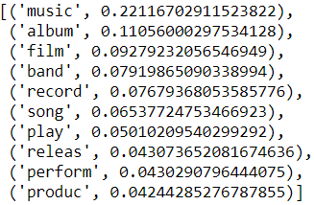
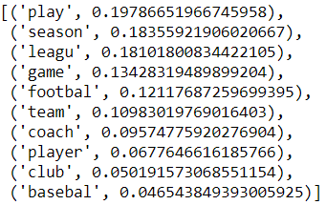
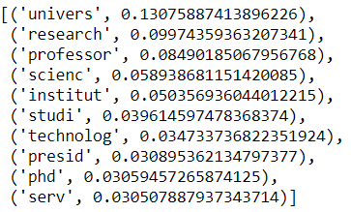
Topic Modeling– 6 topics
Artist – 1
Athlete – 1 - competition
Politician
Artist – 2 - Musician
Athlete – 2 – ball game
Scientist

Slide 8
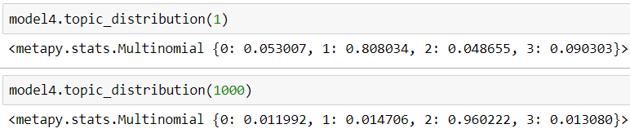
Topic Modeling– Topic Distribution
I would use 4 topics modeling
We can use topic distribution to find the topic of each document:
The order of topics is Politician -> Scientist -> Athlete -> Artist
For example, id = 1 (Alfred J. Lewy) was Scientist;
id = 1000 (Conradign Netzer) was Athlete

Slide 9
Topic Modeling -Topics Tag
Although the topic modeling works in most case, some are incorrect
For example, id = 0 (Digby Morrell) is used to be athlete and currently a teacher on campus. He would have two columns higher than 0.25 but both of them not significant large.
In this case, I used “higher than 0.25” to decide whether the topic is linked to the person, other than “max weight”

Slide 10
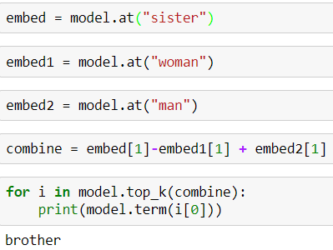
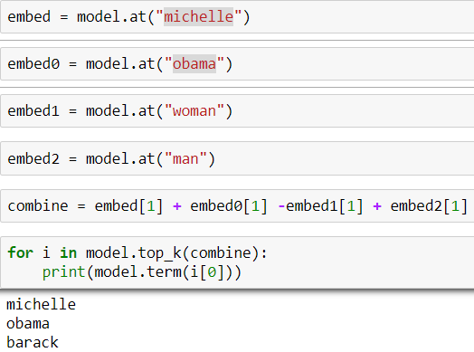
Word Embedding
Word2vec
sister - woman + man
michelle + obama - woman + man

Slide 11
Word2vec – “Barack Obama” example
Words related to “Barack Obama”
People:
Obama, Barack, Clinton, Bush, Reagan, Ronald, Karzai, Carter, Obasanjo, Michelle, Nominee, Yeltsin, Hillary…
Other:
Presidentelect, Inauguration, administrations, presidential, senator, succeeded, FDA…
Everything looks so great!
However, it won’t work in common names

Slide 12
Word2vec – “Pablo Picasso” example
Words related to “Pablo Picasso”
People had name “Pablo”:
Neruda (Pablo Neruda), Montoya (Juan Pablo Montoya), Sarasate (Pablo de Sarasate)…
Words related to other “Pablo”:
Juan, Marichal (related to Juan Pablo Montoya)…
Non-related:
Rachmaninov, Eduardo, Toussaint…
Related:
Plato, Matisse…
We can easily find the result is bad.

Slide 13
Word2vec – Potential Solution
1. Replace all the names as one word:
Such as: “Pablo Picasso” -> “Pablo_Picasso”
However, other document might use “Pablo” refer to “Pablo Picasso”, it would be hard to get all reference updated
2. Try other word embedding algorithm:
Such as: Doc2vec, treat the whole document as a word
However, this time even “Barack Obama” won’t give a correct result.

